Slide 1
Traditional view
Data Administration: - definitions and standards
Data policies, procedures, standards
Planning
Data conflict (ownership) resolution
Managing the information repository
Internal marketing of DA concepts
Database Administration: dealing with technical issues such as
Selection of DBMS and software tools
Installing/upgrading DBMS
Tuning database performance
Improving query processing performance
Managing data security, privacy, and integrity
Data backup and recovery

Slide 2
Modern Approaches
Blend data and database administration into one role
Fast-track development–monitoring development process (planning, analysis, design, implementation, maintenance)
Specialization:
  Procedural DBAs–managing quality of triggers and stored procedures
  eDBA–managing Internet-enabled database applications
  PDA DBA–data synchronization and personal database management
Data warehouse administration

Slide 3
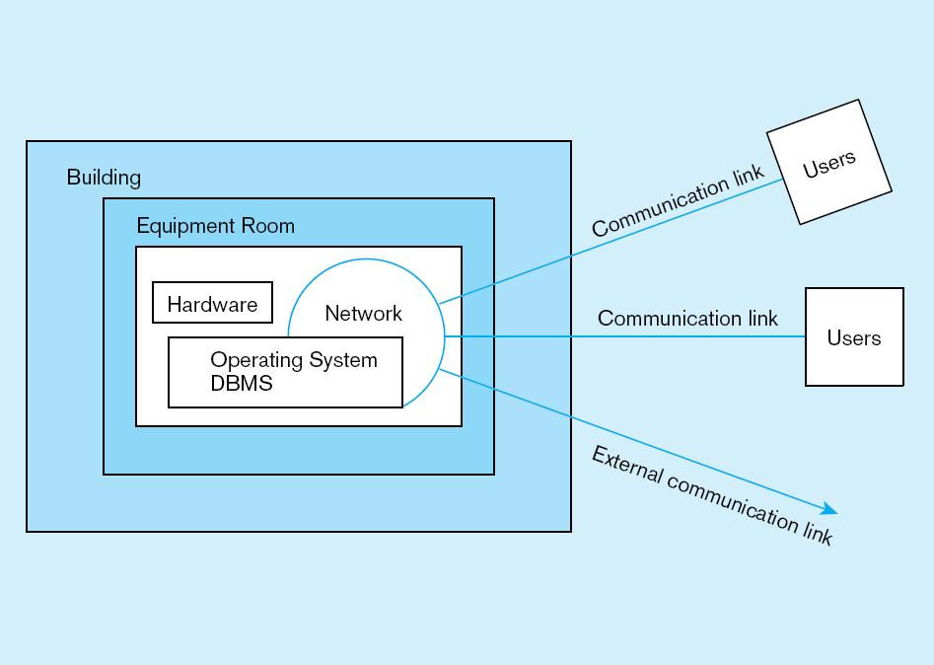
Database Security
Database Security: Protection of the data against accidental or intentional loss, destruction, or misuse is one of the key roles of a DBA
Possible locations of data security threats:

Slide 4
Threats to Data Security
Accidental losses attributable to:
  Human error
  Software failure
  Hardware failure
Theft and fraud
Improper data access:
  Loss of privacy (personal data)
  Loss of confidentiality (corporate data)

Slide 5
W3C Web Privacy Standard
Platform for Privacy Protection (P3P)
Addresses the following:
  Who collects data
  What data is collected and for what purpose
  Who is data shared with
  Can users control access to their data
  How are disputes resolved
  Policies for retaining data
  Where are policies kept and how can they be accessed

Slide 6
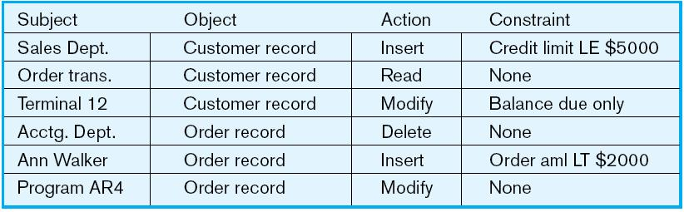
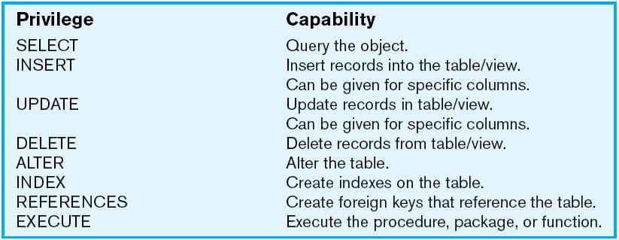
Database Software Security Features
  Views or subschemas - Subset of the database that is presented to one or more users
  Integrity controls - Protect data from unauthorized use
Authorization rules - Controls incorporated in the data management system
User-defined procedures to customize the authorization process

Slide 7
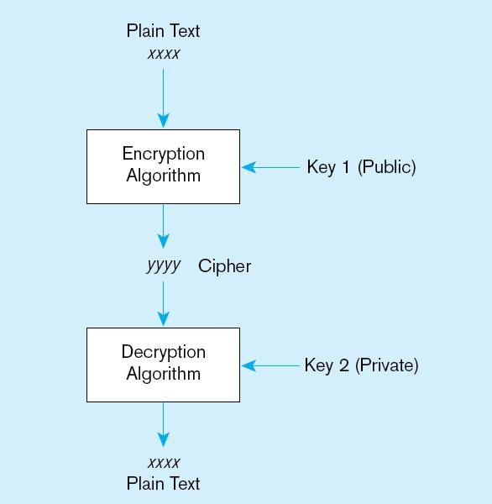
Encryption – the coding or scrambling of data so that humans cannot read them
Authentication schemes - obtain a positive identification of the user e.g. Passwords, biometric devices, smart cards, digital certs
Backup & journalizing features of the DBMS
Security Policies - Personnel controls, Physical access controls, Maintenance controls, Data privacy controls etc

Slide 8
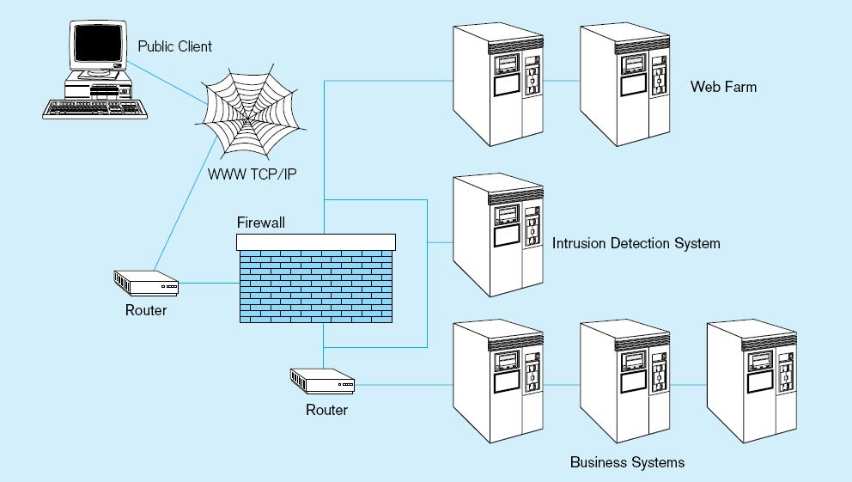
Increased difficulty due to Internet access & client/server technologies
Establishing Internet Security

Slide 9
Web Security features
Static HTML files are easy to secure
  Standard database access controls
  Place Web files in protected directories on server
Dynamic pages are harder
  Control of CGI scripts
  User authentication
  Session security
  SSL for encryption
  Restrict number of users and open ports
  Remove unnecessary programs

Slide 10
Database Recovery
Mechanism for restoring a database quickly and accurately after loss or damage
Recovery facilities:
  Backup Facilities
  Journalizing Facilities - audit trails
  Checkpoint Facility – system pauses to synchronize logs and DB
  Recovery Manager

Slide 11
1. Back-up Facilities
Automatic dump facility that produces backup copy of the entire database
Periodic backup (e.g. nightly, weekly)
Cold backup–database is shut down during backup
Hot backup–selected portion is shut down and backed up at a given time
Backups stored in secure, off-site location

Slide 12
2. Journalizing Facilities
Audit trail of transactions and database updates
Transaction log–record of essential data for each transaction processed against the database
Database change log–images of updated data
  Before-image–copy before modification
  After-image–copy after modification
Produces an audit trail

Slide 13
3. Checkpoint Facilities
DBMS periodically refuses to accept new transactions
➔ system is in a quiet state
Database and transaction logs are synchronized
This allows recovery manager to resume processing from short period, instead of repeating entire day

Slide 14
4. Recovery and Restart Procedures
Disk Mirroring–switch between identical copies of databases
Restore/Rerun–reprocess transactions against the backup
Transaction Integrity–commit or abort all transaction changes
  Backward Recovery (Rollback)–apply before images
  Forward Recovery (Roll Forward)–apply after images (preferable to restore/rerun)

Slide 15
Database Failure Responses
Aborted transactions
  Preferred recovery: rollback
  Alternative: Rollforward to state just prior to abort
Incorrect data
  Preferred recovery: rollback
  Alternative 1: rerun transactions not including inaccurate data updates
  Alternative 2: compensating transactions
System failure (database intact)
  Preferred recovery: switch to duplicate database
  Alternative 1: rollback
  Alternative 2: restart from checkpoint
Database destruction
  Preferred recovery: switch to duplicate database
  Alternative 1: rollforward
  Alternative 2: reprocess transactions

Slide 16
Database Performance Tuning
DBMS Installation - Setting installation parameters
Memory Usage - Set cache levels & Choose background processes
Input/Output (I/O) Contention – Distribution of heavily accessed files
CPU Usage - Monitor CPU load
Application tuning - Modification of SQL code in applications

